Slide 1
Code Sprint 2023: MUDDI GML Writing with FME CityGML3 Tests
Dean Hintz
Trent Kading

Slide 2
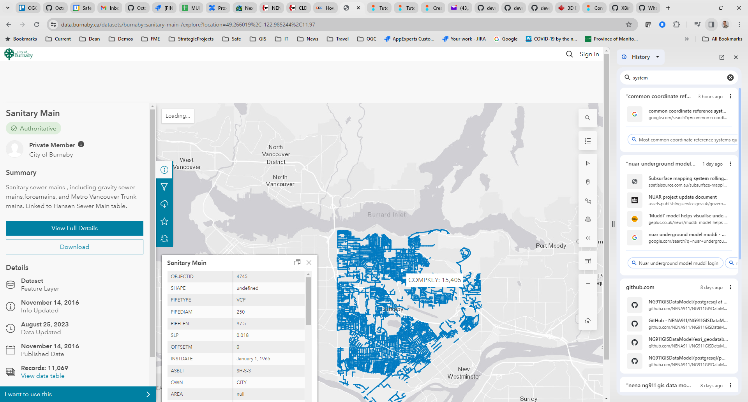
Input data: Burnaby Sanitary Sewer - GeoJSON

Slide 3
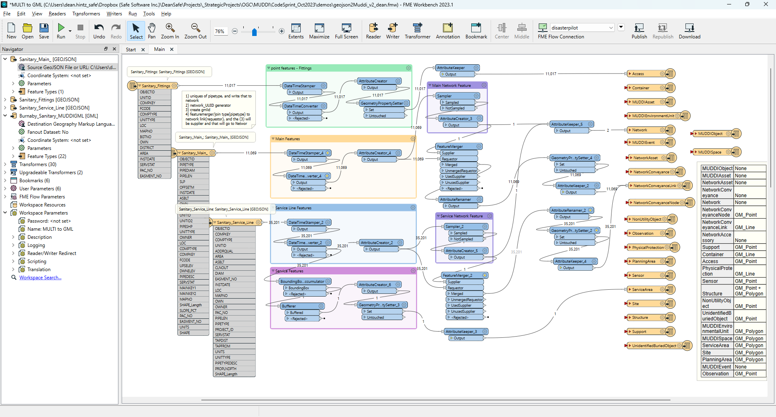
FME Workflow: Burnaby GeoJSON to MUDDI GML

Slide 4
Data Transform Process
Read GeoJSON
Generate and convert timestamps to ISO format
Map attributes from source to MUDDI schema
Create missing attributes, including all required attributes
Create parent network features
Generate gml_ids from UUIDs and gml_parent_ids to associate network elements with parent networks
Set geometry property
Write MUDDI GML using ApplicationSchema.xsd from Interactive Instruments
Note: GML writer - Import Schema:
https://community.safe.com/s/article/gml-writing-with-application-schemas

Slide 5
Validation Errors
XML Validation: Error in ‘./MUDDIgmlTest.xml' on line 16, column 16: 'element 'geometry' is not allowed for content model '(metaDataProperty*,description?,descriptionReference?,identifier?,name*,boundedBy?,location?,businessContact,certification?,dataOwner?,dataOwnerUniqueID?,dataProviderUniqueID?,dataProvider,dataSensitivityLevel?,dateDataCollected?,dateOfLastStatusChange?,description?,featureType?,guidance*,horizontalCRS,measurementUnits?,operationalStatus?,originalDateDataCollected?,systemID,systemLoadDate,version?,objectID,verticalCRS?,recordID,encloses?,enclosedBy*,centroidXYZ?,depth?,depthMethod?,enhancedMeasures?,enhancedMeasuresProximity?,horizontalAccuracy?,horizontalMeasurementMethod?,intendedPermanence?,emergencyContact,localeReference*,locationType?,assetName?,assetOwner?,assetOwnerID?,operator?,qualityLevel?,undergroundStatus?,material?,verticalAccuracy?,colour?,azimuth,container?,dateOfInstallation?,insideHeight?,insideLength?,insideWidth?,isAuxiliary?,isCathodicProtected?,isEncased?,isNPS?,outsideHeight?,outsideLength?,outsideWidth?,protectiveMaterial?,utilitySubType?,utilityType?,wallThickness?,siteOf?,accessoryType,associatedAssets*,hasAccessory?,accessType?,numberOfCovers?,geometry)‘’
Required: businessContact, dataProvider, horizontalCRS, objectID, recordID, emergencyContact, accessoryType, geometry

Slide 6
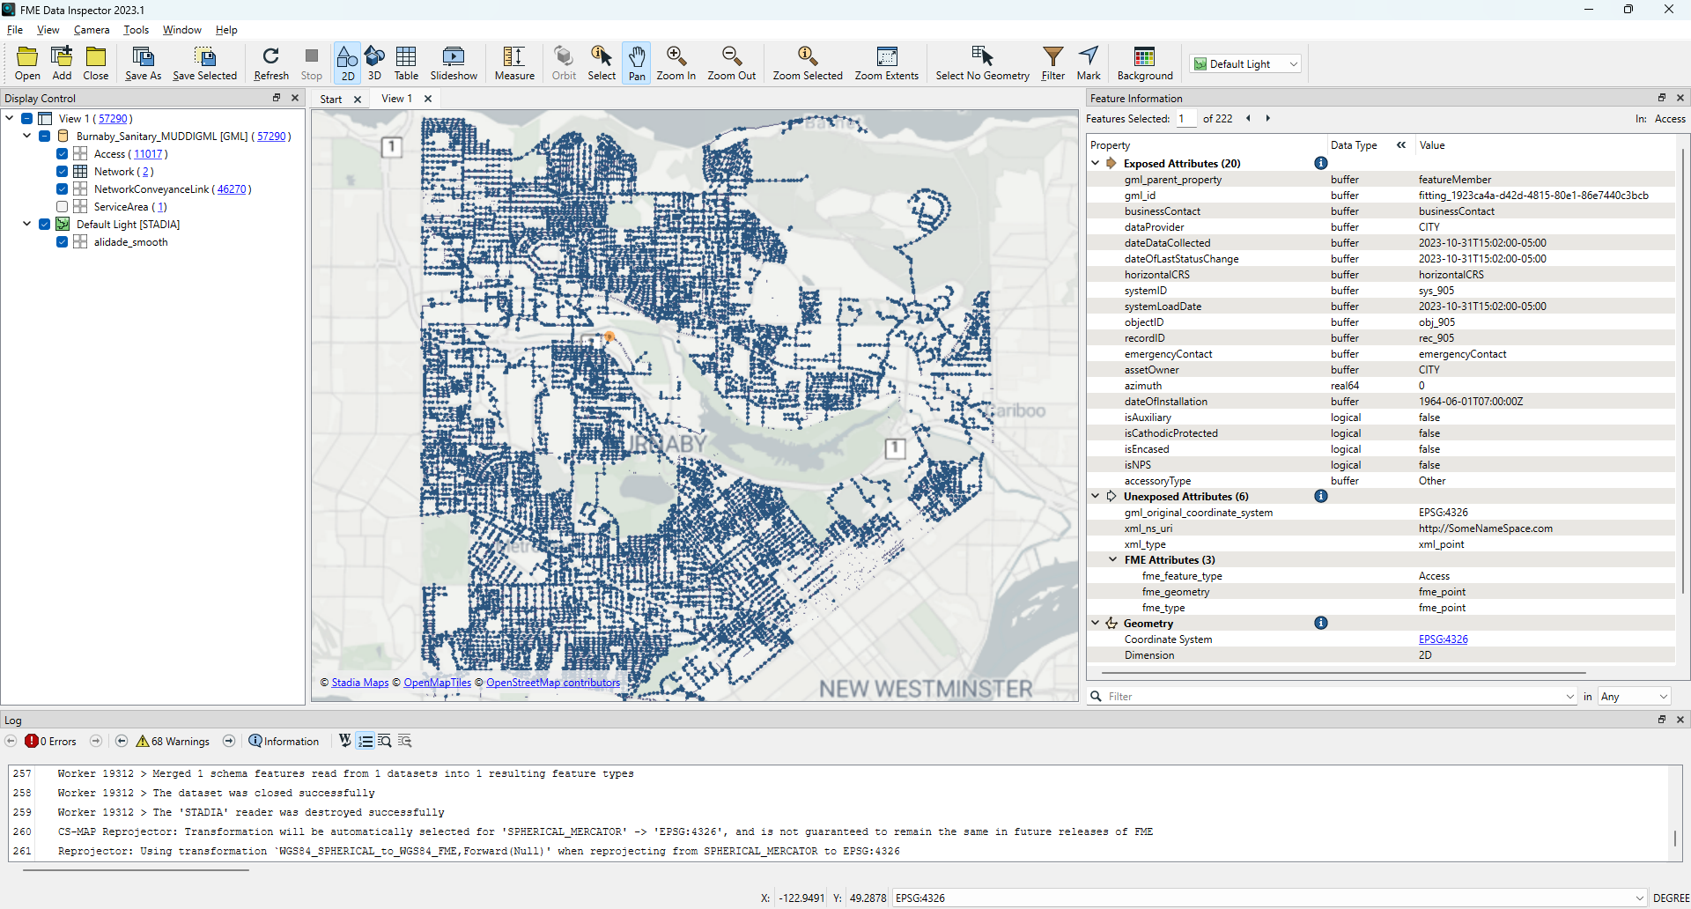
Output: Burnaby Sewer MUDDI GML

Slide 7
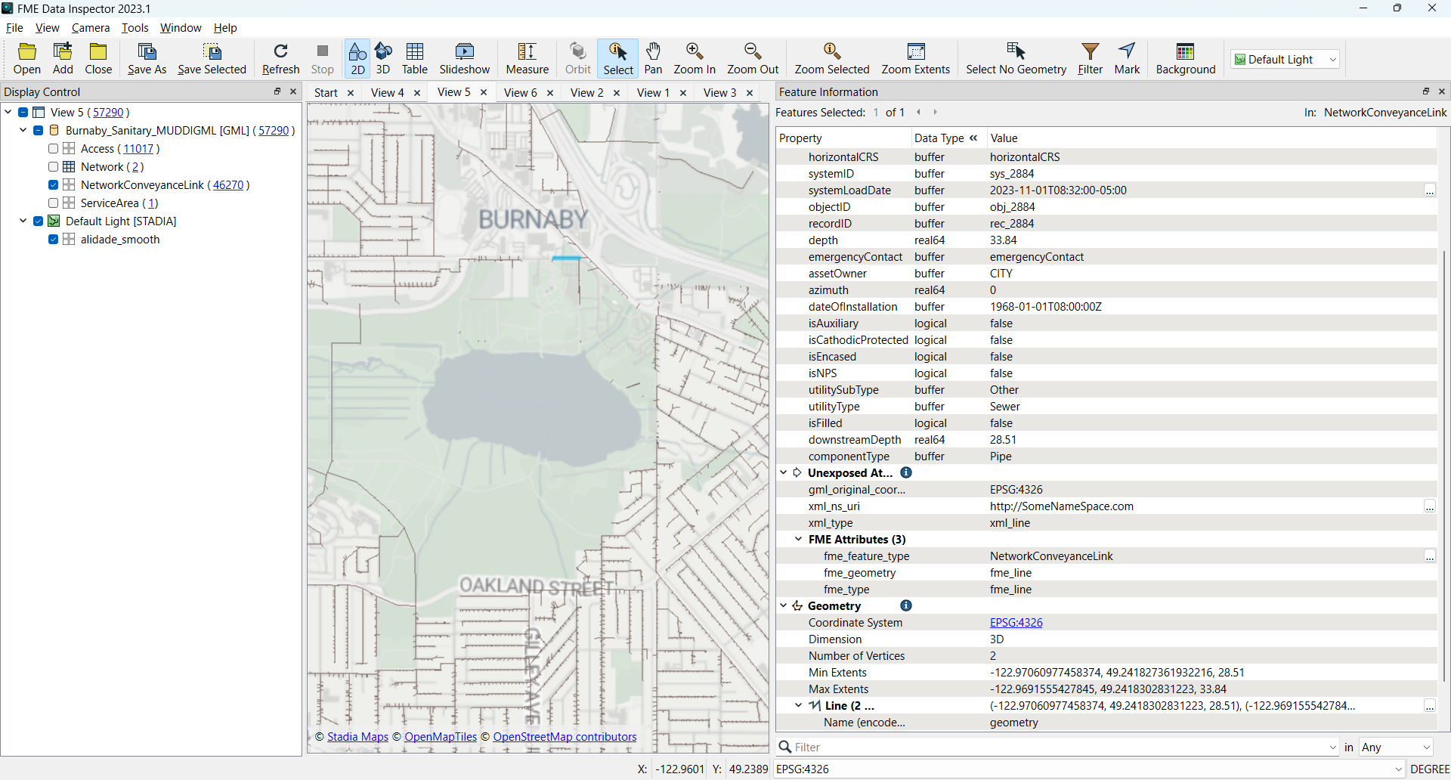
Output:
MUDDI GML: Burnaby Sewer
3D line geometry for network links interpolated from source start, end heights

Slide 8
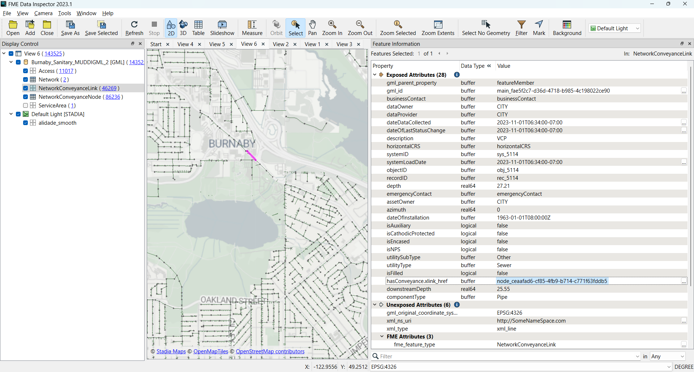
Output:
MUDDI GML: Burnaby Sewer
xlink_href to associate edges with nodes for topology

Slide 9
CityGML3
Montreal CityGML2 to CityGML3
IFC to CityGML3 - duplex

Slide 10
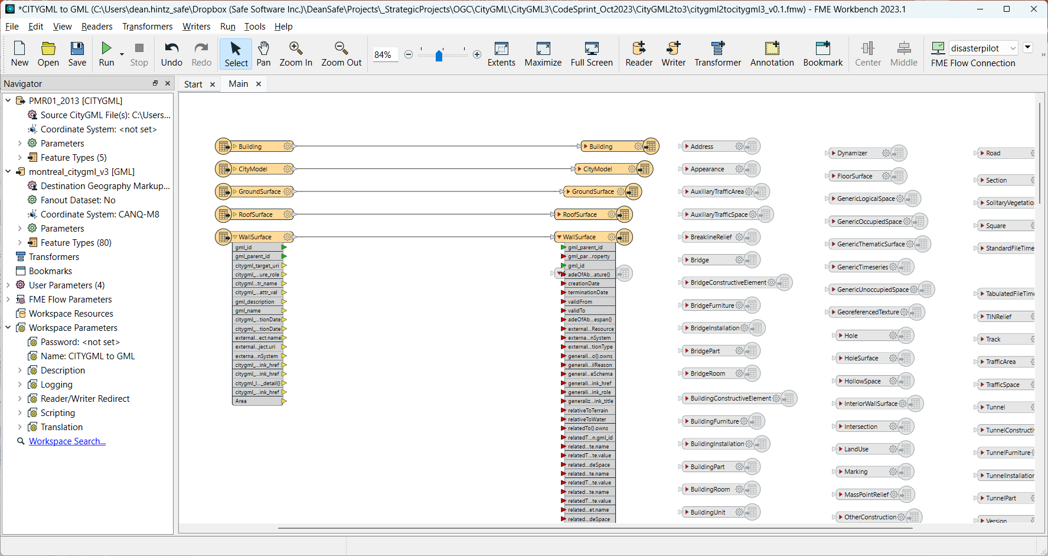
Montreal CityGML2 to 3: FME Workflow

Slide 11
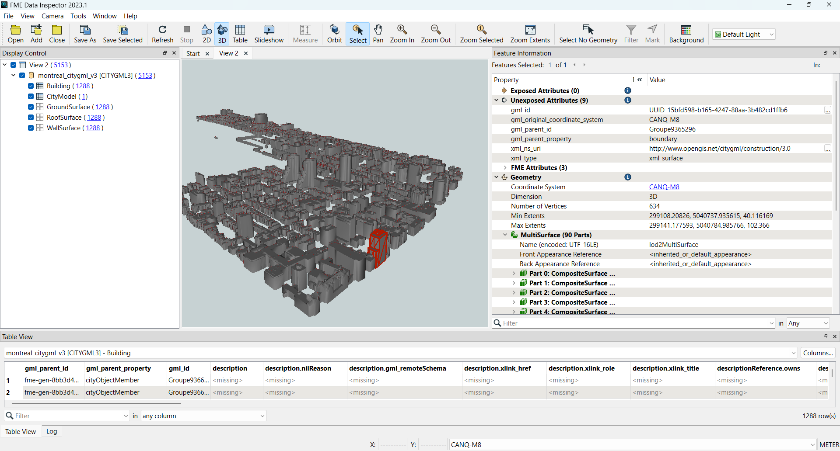
Montreal CityGML2 to 3: Output

Slide 12
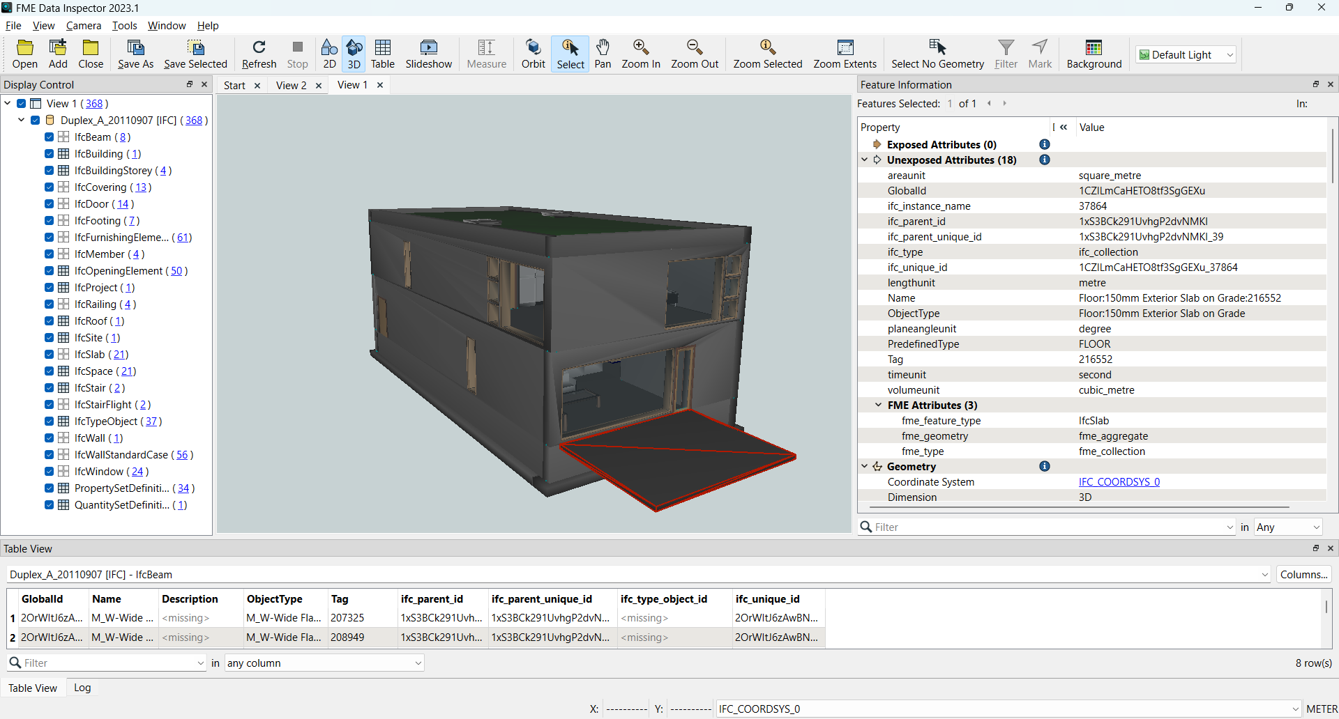
IFC Input: Duplex_A_20110907.ifc

Slide 13
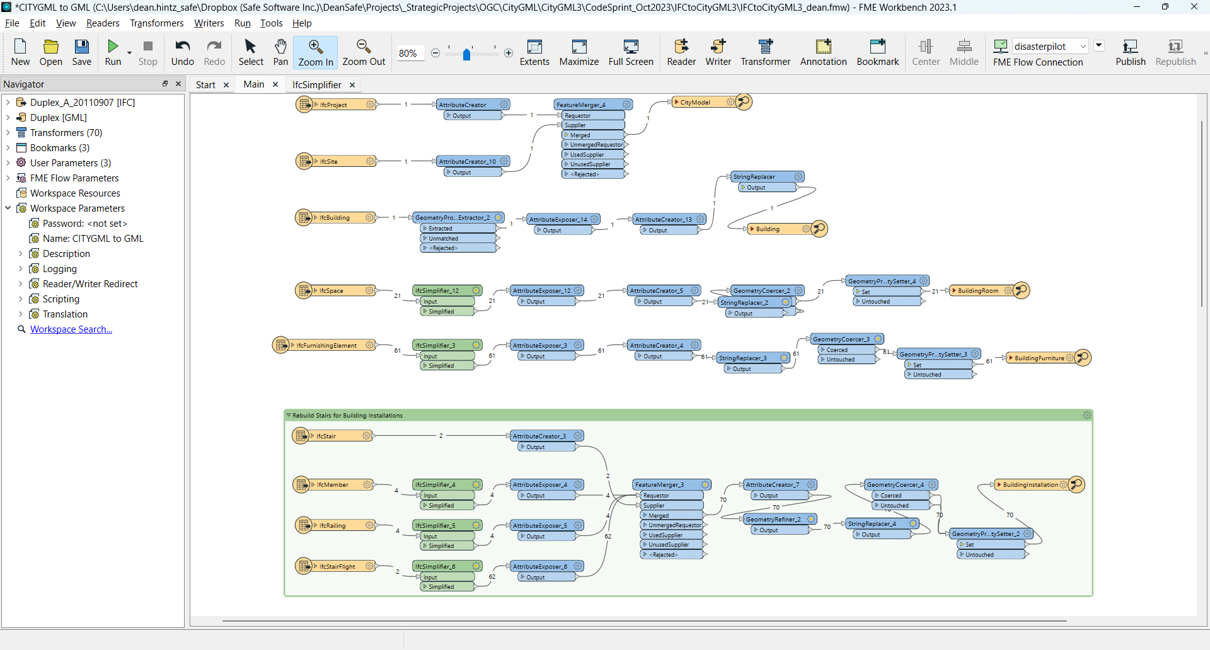
IFC to CityGML3 FME workflow (Dave Campanas)

Slide 14
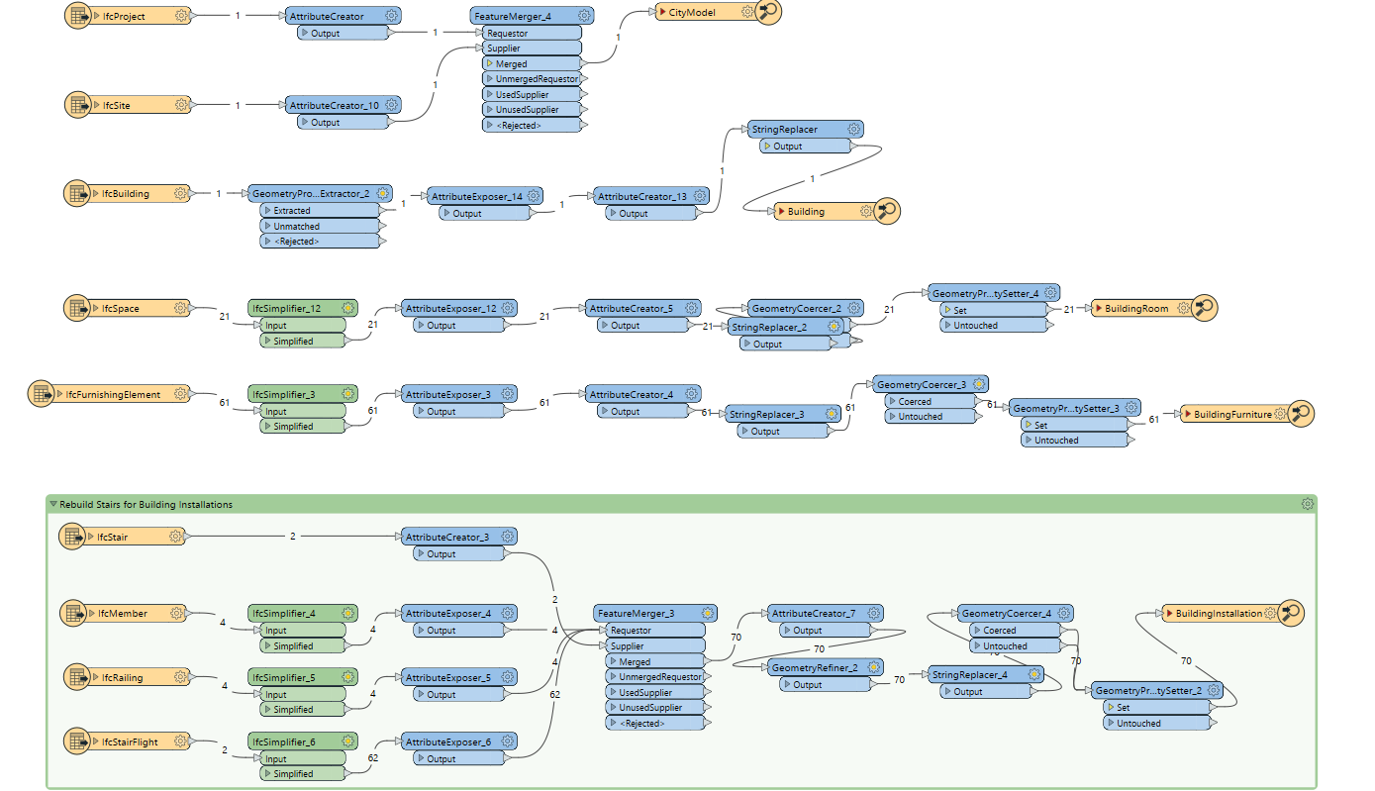
IFC to CityGML3 FME workflow pt1

Slide 15
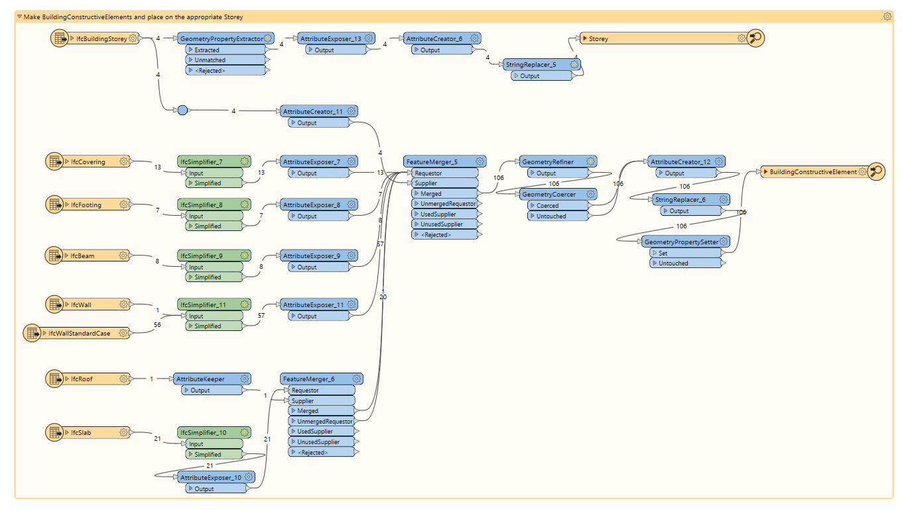
IFC to CityGML3 FME workflow pt2

Slide 16
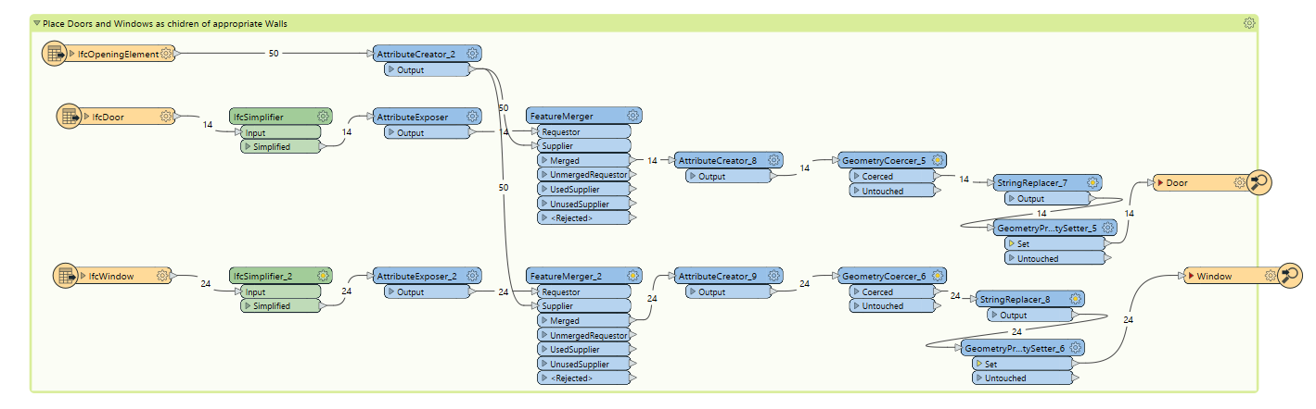
IFC to CityGML3 FME workflow pt3

Slide 17
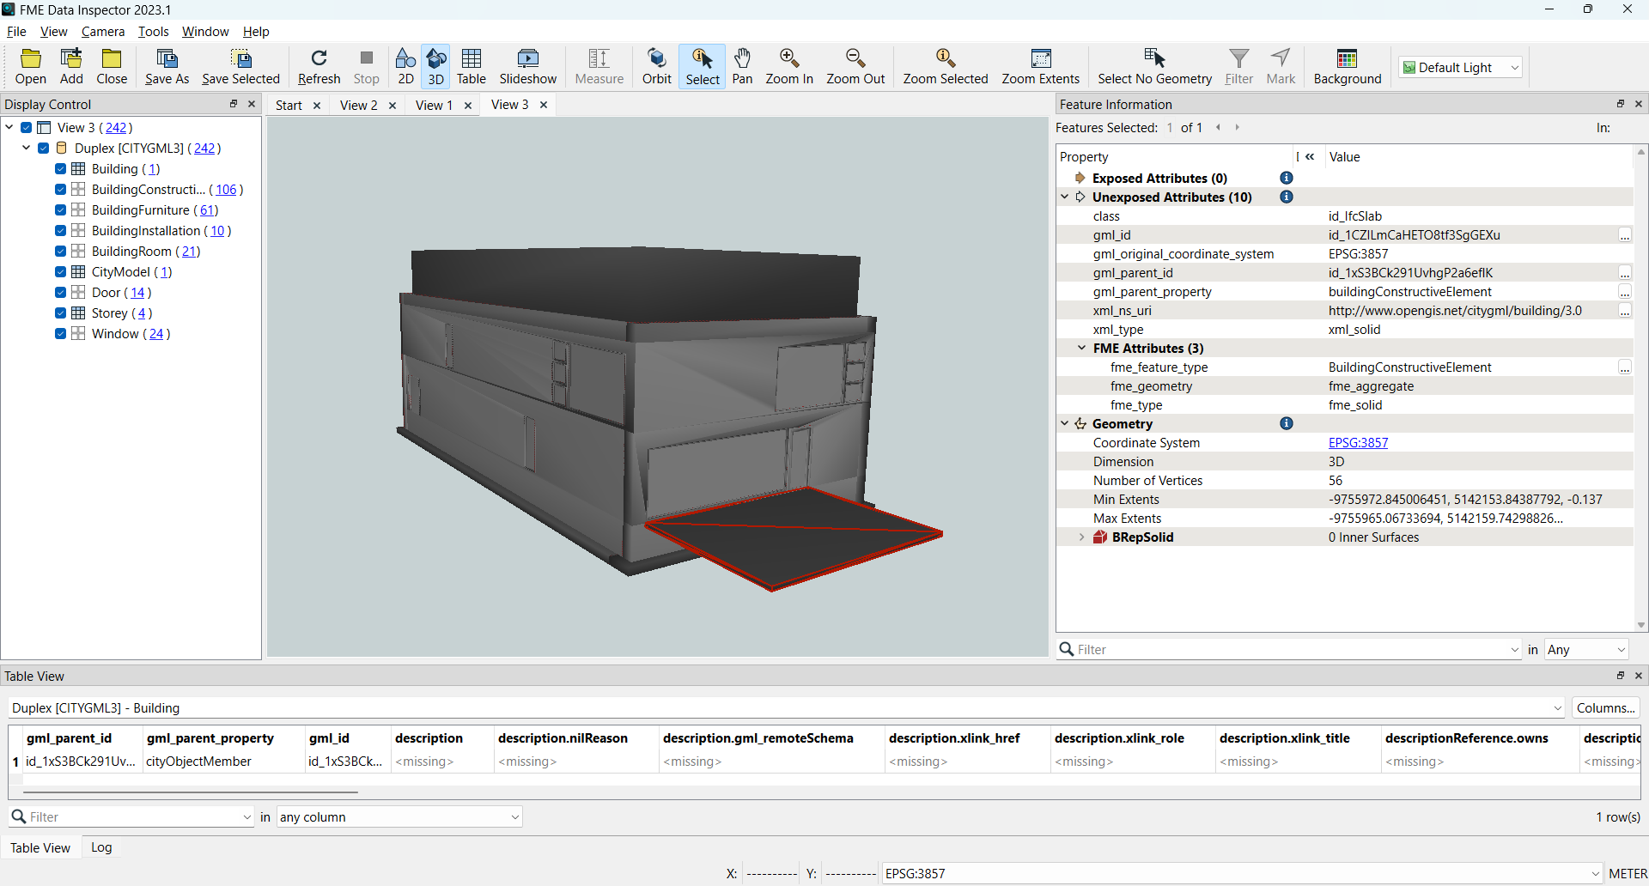
CityGML3 output: BuildingConstructiveElement

Slide 18
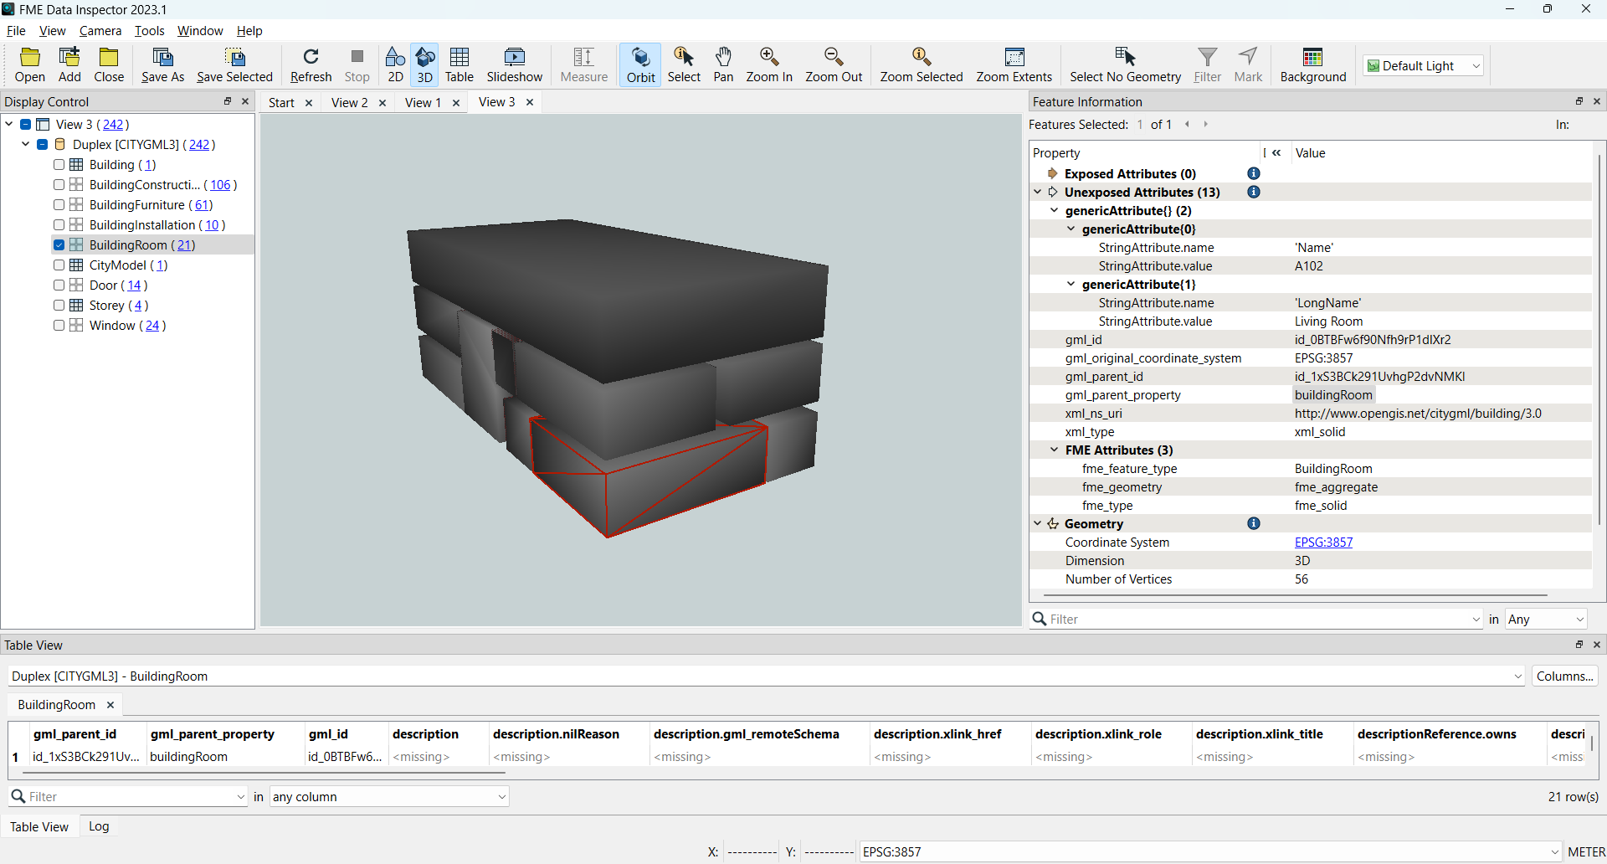
CityGML3 output: BuildingRoom with generic attributes

Slide 19
CityGML3 output: BuildingRoom with generic attributes

Slide 20
Conclusions
MUDDI with FME
Wrote to MUDDI GML
Captured multiple geometry types: points, lines, polygons, 2d,3d
Populated complex schema elements including topology xlink_hrefs
CityGML3 with FME
Converted CityGML2 to 3 but still losing appearances (support coming with CityGML3 writer in 2024 Q1
IFC to CityGML3 – now able to store IFC spaces as rooms and support a range of other new CityGML3 feature types and properties (Story)
Read output back in with new CityGML3 reader

Slide 21
Thank you
dean.hintz@safe.com
www.safe.com/fme

